Slide 1

Module 1 - Class 2.1
How to get Waze data

Slide 2
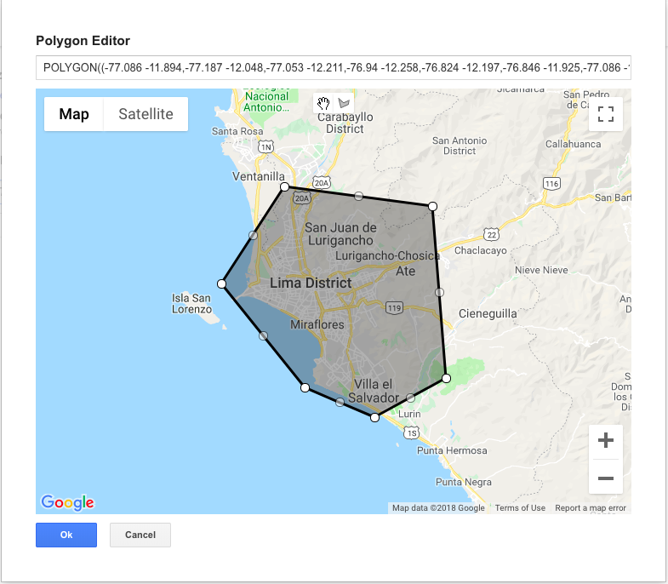
2.2 Drawing a polygon over the city

Slide 3
2.3 The URL of the Waze GeoRSS API
https://<something-confidential>?format=JSON&acotu=true&irmie=true&types=traffic%2Calerts%2Cirregularities&tk=ccp_partner&ccp_partner_name=Organization+Partner+Name&polygon=-78.674,-0.641;-78.405,-0.718;-78.235,-0.515;-78.169,-0.174;-78.064,-0.190;-77.845,0.006;-77.965,0.171;-78.064,0.188;-78.257,0.122;-78.421,0.248;-78.669,0.210;-78.993,0.254;-79.234,0.341;-79.333,0.248;-79.267,0.144;-79.366,0.072;-79.295,0.001;-79.200,-0.051;-79.157,-0.081;-78.850,-0.130;-78.751,-0.245;-78.839,-0.350;-78.921,-0.339;-78.833,-0.509;-78.745,-0.547;-78.674,-0.641

Slide 4

2.4 Capturing the data with Python

Slide 5

2.5 Storing the data from JSON to PostgreSQL

Slide 6
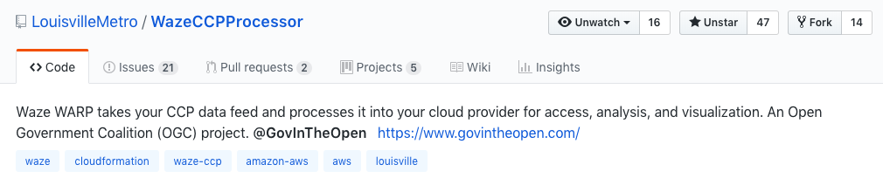
2.6 Some community solutions

Slide 7
See you in the next video!

